Slide 1

School Management Systems

Slide 2
Presented by –
Md. Monzurul Alam Sajal (19202103007)
Sourov Karmokar (19202103020)
Sihab Mahmud (19202103032)
Sourav Hazra (19202103036)
Supervised by –
Mst. Jannatun Ferdous
Lecture, Department of CSE
Bangladesh University of Business
and Technology (BUBT)

Slide 3
Education system forms the backbone of every nation. And hence it is important to provide a strong educational foundation to the young generation to ensure the development of open-minded global citizens securing the future for everyone. Advanced technology available today can play a crucial role in streamlining education-related processes to promote solidarity among students, teachers, parents and the school staff. School Management System consists of tasks such as registering students, attendance record keeping controlling absentees, producing report cards. producing official transcript, preparing timetable and producing different reports for teachers and parents The appearance of your student records says a lot about the quality of your school Other educators and registrars make judgments based on student records that can permanently affect a student's life. SMS capabilities include the basics such as transcripts, report cards, attendance, and discipline as well as many other specialized capabilities, including parental access to real time student grades on the Internet. This means that not only administrators but also. parents, teachers, and students have access to real-time data.
Introduction

Slide 4
Objective
The main objective of the School Management System is to manage the details of Schools, Students, Classes, Teachers, Registrations. It manages all the information about Schools, Cources Registrations, Schools. The project is totally built at administrative end and thus only the administrator is guaranteed the access

Slide 5
Features
1. Management Dashboard.
2. Data analysis and reports.
3. Inquiries and admission tracking.
4. Student profile tracking for parent's meet / key inputs.
5. Class wise performance tracking.
6. Teachers activity analysis.
7. Lesson progress tracking.
8. Fees and financial data analysis.

Slide 6
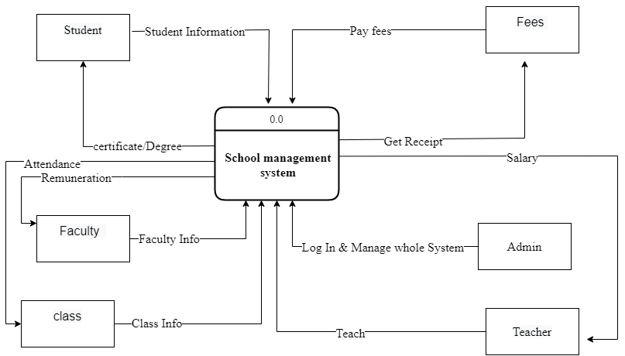
Data Flow Diagram (Context level )

Slide 7
The END

